Slide 1
Unit 3: Network Switching
3.1 What’s inside a router (basic concepts of switching)
3.2 Other interconnection devices
Physical-layer hubs
Link-layer switches
Link-layer bridges
Performance Comparison
3.3 Trend of simplifying architecture
IP over ATM
IP over SDH
IP over WDM
3.4 Switching technology
Switching concepts
Multilayer switching
MPLS
3.5 Data center networking

Slide 2
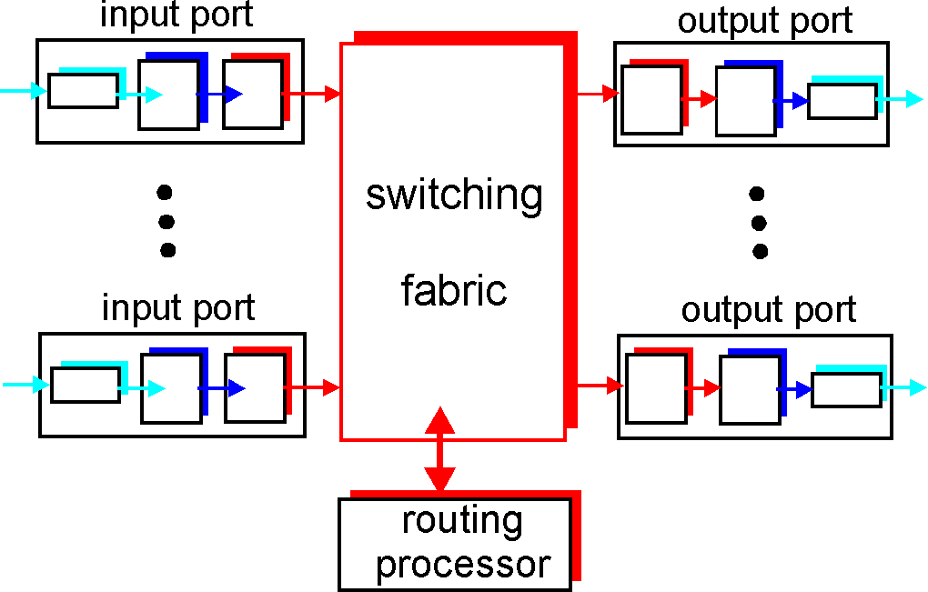
Router Architecture Overview
Two key router functions:
run routing algorithms/protocol (RIP, OSPF, BGP)
forwarding datagrams from incoming to outgoing link
Switching fabric is a network inside a router, connecting input ports to output ports
Routing processor executes routing protocols, maintains routing tables, and performs network management functions

Slide 3
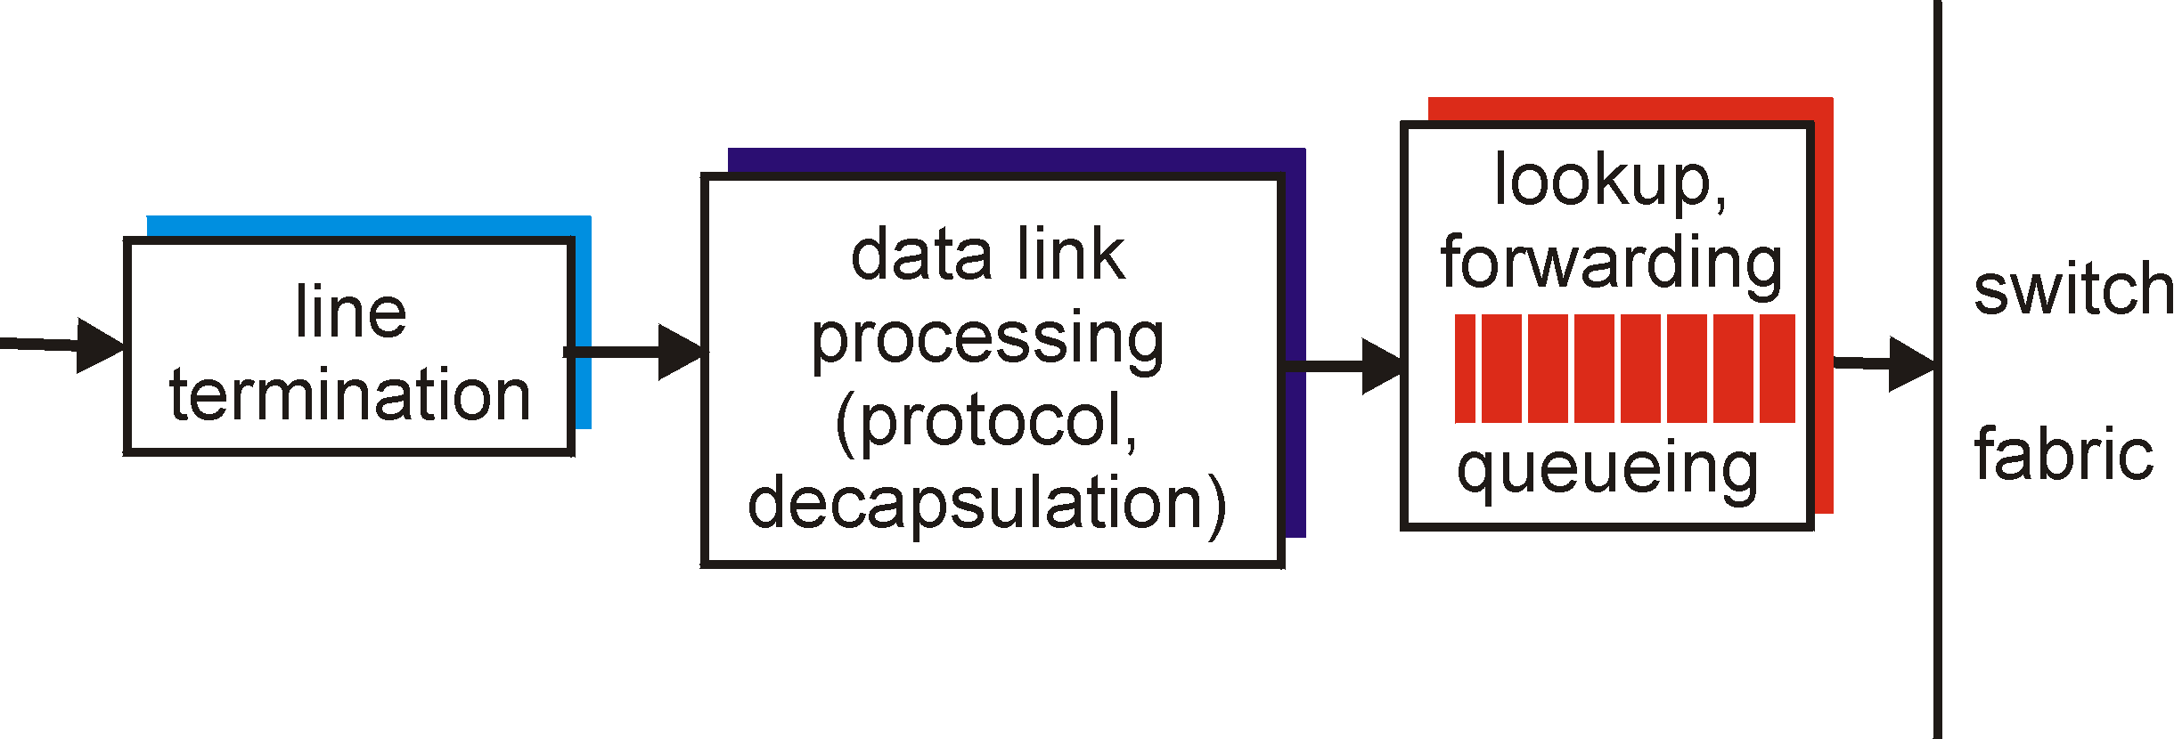
Input Port Functions
Physical layer:
bit-level reception
Data link layer:
e.g., Ethernet
Decentralized switching:
given datagram dest., lookup output port using local copies of the forwarding table in input port memory (decision made locally at each input port)
goal: complete input port processing at ‘line speed’
queuing: if datagrams arrive faster than forwarding rate into switch fabric
T_{lookup} < T_{packet-receiving}

Slide 4
Router Linecard
OC192c linecard
Lookup
Tables
Buffer
& State
Memory
Optics
Packet
Processing
Buffer Mgmt
&
Scheduling
Physical
Layer
Framing
&
Maintenance
Buffer Mgmt
&
Scheduling
30M gates
2.5Gbits of memory
~300W
1m²
$25k cost, $100k price.
Buffer
& State
Memory
Switch Fabric
By Nick McKeown, Stanford

Slide 5
Performance Requirements for A Lookup
T_{lookup} < T_{packet-receiving}, for a lookup to be performed in less than the amount of time needed to receive a packet at the input port
To get an idea of the performance requirements for a lookup, consider
an OC-48 link runs at 2.5 Gbps with packets 256 bytes long
Please calculate the lookup # per second
2.5 Gbps ÷ (256 x 8) =2.5 x 10⁹ ÷ 2048 ≈ 10⁶ i.e., 1 million lookups per second
implies a lookup speed of approximately 1 million lookups per second.

Slide 6
Non-specialized Router
In routers with limited processing capabilities at the input port,
the input port simply forward the packet
the routing centralized processor then lookup the forwarding table and forward the packet to the appropriate output port.
Problem: A forwarding processing bottleneck at a single point within the router
This is the approach taken when a workstation or a server serves as a router
the routing processor ～ just the workstation's CPU
the input port ～ just a network interface card (for example, an Ethernet card).

Slide 7
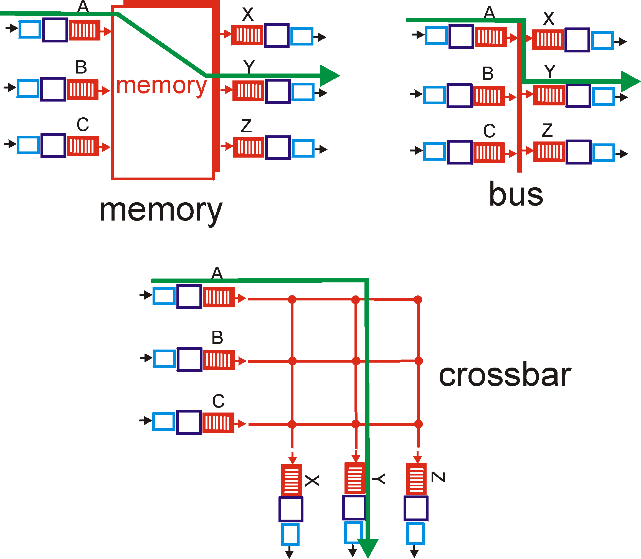
Three types of switching fabrics

Slide 8
Switching Via Memory
First generation routers: (slowest switching type)
traditional computers with switching under direct control of CPU
packet copied to system’s memory
speed limited by memory bandwidth
Input
Port
Memory
Output
Port
System Bus

Slide 9
Switching Via a Bus
datagram from input port memory
to output port memory via a shared bus
bus contention: one packet at a time, otherwise collision will happen. switching speed limited by bus bandwidth
32 Gbps bus, Cisco 5600: sufficient speed for access and enterprise routers (not regional or backbone)
A moderate switching type

Slide 10
Switching Via An Interconnection Network
Overcome bus bandwidth limitations
A crossbar switch is an interconnection network consisting of 2n buses that connect n input ports to n output ports.
Advanced design: fragmenting datagram into fixed length cells, switch cells through the fabric.
Cisco 12000: switches 60 Gbps through the interconnection network
The fastest switching type

Slide 11
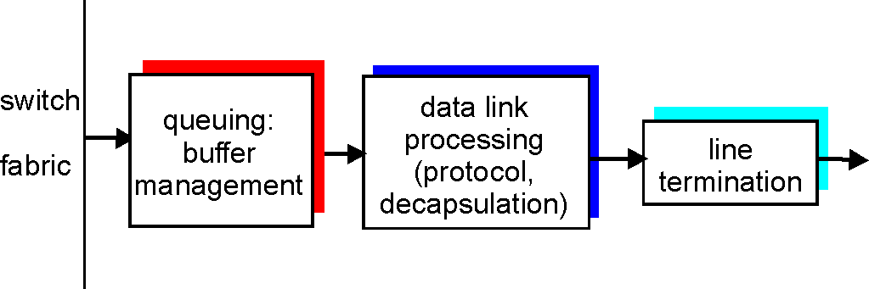
Output Ports
When a link is bidirectional, an output port to the link will typically be paired with the input port
Buffering required when datagrams arrive from fabric faster than the transmission rate
Scheduling discipline chooses among queued datagrams for transmission
The output port thus performs the reverse data link- and physical-layer functionality of the input port

Slide 12
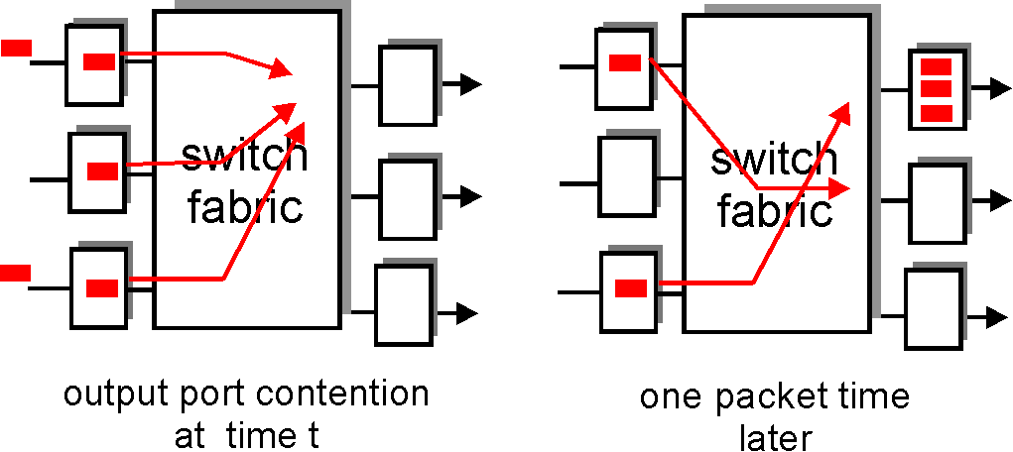
Output port queueing
buffering when arrival rate via switch exceeds output line speed
queuing (delay) and loss due to output port buffer overflow!
Consequence: a packet scheduler at the output port must choose one packet, e.g., selection can be based on first-come-first-served (FCFS) scheduling.

Slide 13
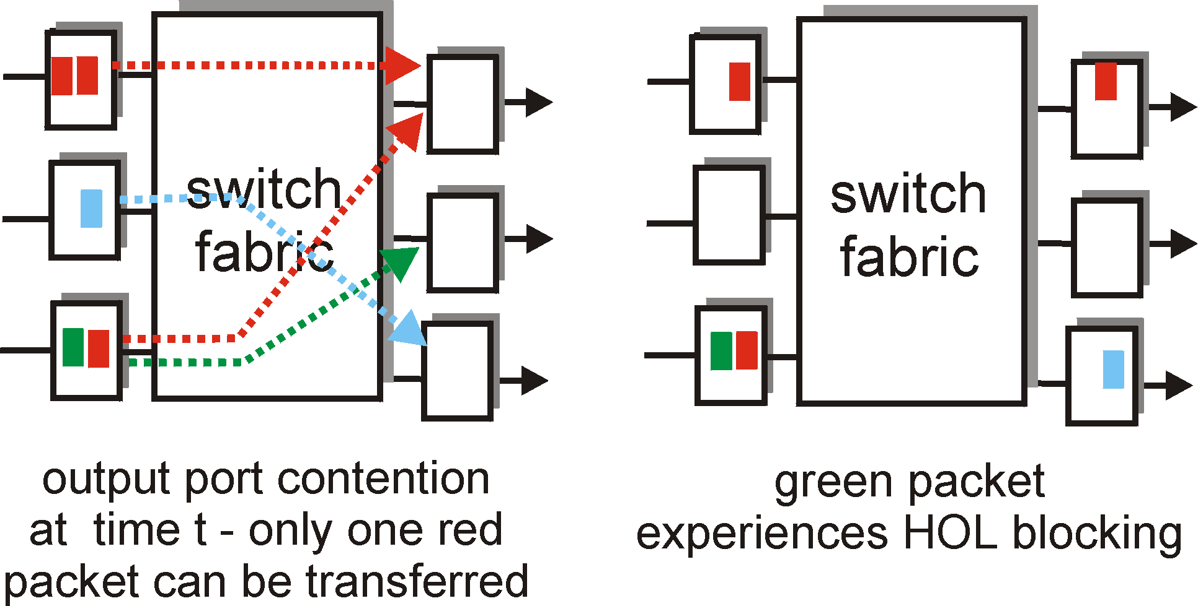
Input Port Queuing
Fabric slower than input ports combined -> queuing may occur at input queues
Head-of-the-Line (HOL) blocking: queued datagram at front of queue prevents others in queue from moving forward
queuing delay and loss due to input buffer overflow!

Slide 14
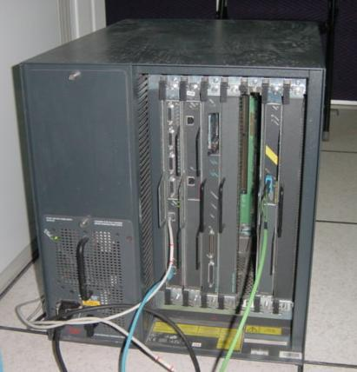
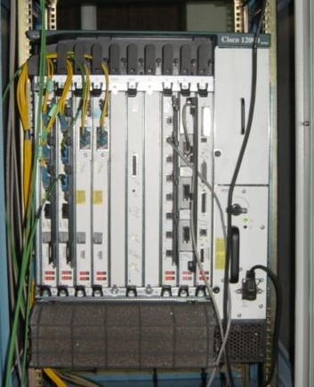
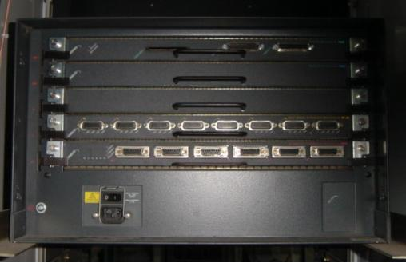
Cisco 7507 - 1998
Cisco 12008 - 2000
Cisco 7010 - 1995

Slide 15
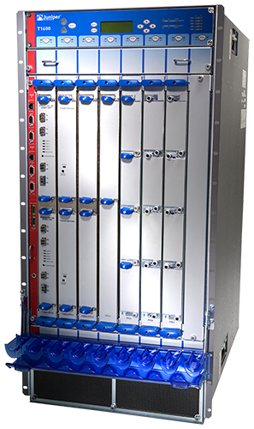
What a High Performance Router Looks Like
44.27cm
Capacity: 1.6Tb/s Power: 7008W TRIO chip：65nm
95.12cm
78.74cm
Juniper T1600
274.88kg

Slide 16
Unit 3: Network Switching
3.1 What’s inside a router (basic concepts of switching)
3.2 Other interconnection devices
Physical-layer hubs
Link-layer switches
Link-layer bridges
Performance Comparison
3.3 Trend of simplifying architecture
IP over ATM
IP over SDH
IP over WDM
3.4 Switching technology
Switching concepts
Multilayer switching
MPLS
3.5 Data-center networking

Slide 17
Hubs
… physical-layer (“dumb”) repeaters:
bits coming in one link go out all other links at same rate
all nodes connected to hub can collide with one another
no frame buffering, no filtering or redirection
no CSMA/CD at hub: host NICs detect collisions
Star topology
Carrier Sense Multiple Access / Collision Detection (CSMA/CD)
Two rules:
1. Listen before speaking (Carrier Sense)
2. If someone else begins talking at the same time, stop talking. (Collision Detection)
twisted pair
hub

Slide 18
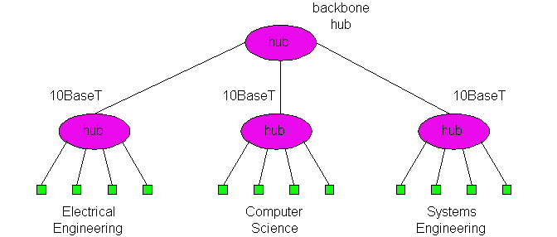
Hubs (more)
Hubs can be arranged in a hierarchy (or multi-tier design), with backbone hub at its top
Simple, inexpensive device
Extends maximum distance between node pairs (100m per Hub)
Hubs are typically used on small networks where the amount of data going across the network is never very high.
portions of the LAN continue to operate if one hub malfunctions

Slide 19
Switch
link-layer device: smarter than hubs, take active role
store, forward Ethernet frames
examine incoming frame’s MAC address, selectively forward frame to one-or-more outgoing links when frame is to be forwarded on segment, uses CSMA/CD to access segment
transparent
hosts are unaware of presence of switches
plug-and-play, self-learning
switches do not need to be configured
Notes:
Carrier Sense Multiple Access with Collision Detection (CSMA/CD) is the LAN access method used in Ethernet.

Slide 20
Switch: allows multiple simultaneous transmissions
A
hosts have dedicated, direct connection to switch
switches buffer packets
Ethernet protocol used on each incoming link, but no collisions; full duplex
each link is its own collision domain
switching: A-to-A’ and B-to-B’ simultaneously, without collisions
not possible with dumb hub
C’
B
1
2
6
3
5
4
C
B’
A’
switch with six interfaces
(1,2,3,4,5,6)
Notes:
Carrier Sense Multiple Access with Collision Detection (CSMA/CD) is the LAN access method used in Ethernet.
CSMA/CA (Carrier Sense Multiple Access/Collision Avoidance) is a protocol for carrier transmission in 802.11 networks.

Slide 21
Switch Table
A
Q: how does switch know that A’ reachable via interface 4, B’ reachable via interface 5?
A: each switch has a switch table, each entry:
(MAC address of host, interface to reach host, time stamp)
Q: how are entries created, maintained in switch table?
something like a routing protocol!
C’
B
1
2
6
3
5
4
C
B’
A’
switch with six interfaces
(1,2,3,4,5,6)

Slide 22
Switch: self-learning
Source: A
Dest: A’
A
A A’
switch learns which hosts can be reached through which interfaces
when frame received, switch “learns” location of sender: incoming LAN segment
records sender/location pair in switch table
C’
B
1
2
6
3
5
4
C
B’
A’
MAC addr interface TTL
A
1
60
Switch table
(initially empty)

Slide 23
Switch: frame filtering/forwarding
When frame received:
1. record link associated with sending host
2. index switch table using MAC dest address
3. if entry found for destination then {
if dest on segment from which frame arrived then drop the frame
else forward the frame on interface indicated
}
else flood
Filtering function
forward on all but the interface
on which the frame arrived

Slide 24
Self-learning, forwarding: example
Source: A
Dest: A’
A
A A’
C’
B
frame destination unknown:
1
2
flood
6
3
A A’
A A’
A A’
A A’
A A’
5
4
destination A location known:
C
selective send
A’ A
B’
A’
MAC addr interface TTL
A
1
60
Switch table
(initially empty)
A’
4
60

Slide 25
Interconnecting switches
switches can be connected together
S₄
S₁
S₃
A
S₂
F
I
B
C
D
E
G
H
Q: sending from A to G - how does S₁ know to forward frame destined to G via S₄ and S₃?
A: self learning! (works exactly the same as in single-switch case!)

Slide 26
Institutional network
Heterogeneous links
Network management
router
mail server
to external
network
1Gbps (fiber)
1Gbps (fiber)
web server
6
5
4
1Gbps (fiber)
switch
1
2
3
100Mbps (fiber)
IP subnet
100Mbps (fiber)
100Mbps (fiber)
Mixture of 10Mbps, 100Mbps, 1Gbps, Cat 5 Cable

Slide 27
Switches vs. Routers
Both store-and-forward devices
routers, as network layer devices, examine L3 headers using L3 addresses;
switches are link layer devices, using MAC addresses
Both maintain tables
routers maintain routing tables, implement routing algorithms;
switches maintain switch tables, implement filtering, learning algorithms
Constructed topology
the active topology of a switched network is restricted to a spanning tree in order to prevent the cycling of broadcast storm;
routers provide firewall protection and allow the network to be built with a rich topology
Notes:
Routers are store-and-forward packet switches that forward packets using network-layer addresses. Although a switch is also a store-and-forward packet switch, it is fundamentally different from a router in that it forwards
packets using MAC addresses. Whereas a router is a layer-3 packet switch, a switch is a layer-2 packet switch.
First consider the pros and cons of switches. As mentioned above, switches are
plug-and-play, a property that is cherished by all the overworked network
administrators of the world. Switches can also have relatively high filtering and forwarding
rates—as shown in Figure 5.29, switches have to process frames only up through layer
2, whereas routers have to process datagrams up through layer 3. On the other hand,
to prevent the cycling of broadcast frames, the active topology of a switched network
is restricted to a spanning tree. Also, a large switched network would require large
ARP tables in the nodes and would generate substantial ARP traffic and processing.
Furthermore, switches do not offer any protection against broadcast storms—if one
host goes haywire and transmits an endless stream of Ethernet broadcast frames, the
switches will forward all of these frames, causing the entire network to collapse.
Because routers do not have the spanning tree restriction, routers have allowed the Internet to
be built with a rich topology that includes.
Another feature of routers is that they provide firewall protection against layer-2 broadcast storms.
Routers often have a larger per-packet processing time than switches, because they have to process
up through the layer-3 fields.
Switches are the same thing as Bridges, but usually have multiple ports with the same "flavor" connection

Slide 28
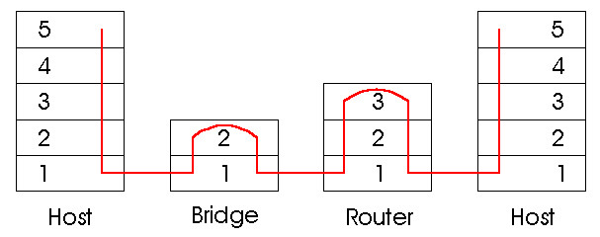
Switches vs. Routers (cont.)
Routers have a larger per-packet processing time (process up through the layer-3 fields)
A large switched network
would require large ARP tables in the nodes
would generate substantial ARP traffic and processing
/ Switch

Slide 29

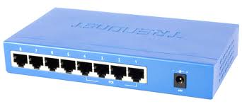
Bridges vs. switches
The main difference between a switch and bridge is the number of network segments each can connect.
A bridge only has one incoming and one outgoing port.
A switch steps up on a bridge in that it has multiple ports and can apparently connect more than two network segments.
Bridges are typically used to connect two LAN segments
Switches can apparently connect more than two networks.

Slide 30


Bridges vs. Switches (cont.)
Switches perform forwarding in hardware, while bridges perform it in software
Bridges are typically used to separate parts of a network that do not need to communicate regularly, but still need to be connected.
Actually, the IEEE specs define bridges... and those bridges have tons of ports, not just two. The difference bridge/switch is mainly marketing.

Slide 31
Bridges: traffic isolation
Bridge installation breaks LAN into LAN segments
bridges filter packets:
segments become separate collision domains
collision
domain
collision
domain
= hub
bridge
= host
LAN segment
LAN segment
LAN (IP network)

Slide 32
Comparison of Typical Features of Popular Interconnection Devices
 | Hubs | Switches | Bridges | Routers
Working Layer | 1 | 2 | 2 | 3
Traffic Isolation | No | Yes | Yes | Yes
Plug & Play | Yes | Yes | Yes | No
Optimal Routing | No | No | No | Yes
Notes:
Given that both switches and routers have their pros and cons, when should an institutional network (for example, a university campus network or a corporate campus network) use switches, and when should it use routers?
Typically, small networks consisting of a few hundred hosts have a few LAN
segments. Switches suffice for these small networks, as they localize traffic and increase
aggregate throughput without requiring any configuration of IP addresses.
But larger networks consisting of thousands of hosts typically include routers within the network
(in addition to switches). The routers provide a more robust isolation of traffic, control
broadcast storms, and use more "intelligent" routes among the hosts in the network.

Slide 33

Rule of thumb
When should an institutional network use switches, and when should it use routers?
Typically, small networks consisting of a few hundred hosts have a few LAN segments. Switches suffice for these small networks
But larger networks consisting of thousands of hosts typically include routers within the network (in addition to switches).

Slide 34
Unit 3: Network Switching
3.1 What’s inside a router (basic concepts of switching)
3.2 Other interconnection devices
Physical-layer hubs
Link-layer switches
Link-layer bridges
Performance Comparison
3.3 Trend of simplifying architecture
IP over ATM
IP over SDH
IP over WDM
3.4 Switching technology
Switching concepts
Multilayer switching
MPLS
3.5 Data-center networking

Slide 35

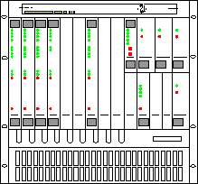
Earlier Network Architecture
Router
Router
VCs
VCs
ATM switch
ATM switch
OC3
OC3
OC12
OC12
OC3
SONET Mux
SONET Mux
OC3
Working Fiber
OC48
OC48
SONET
Transport
SONET
Transport
SONET/SDH Ring
Protection Fiber
Simple overlay of functions

Slide 36
IP over ?
20% of cell tax
IP
60% of the cost is from nodes
Not enough granularity
Reliability duplicated by IP
Use only one wavelength
FR
IP
ATM
ATM
IP
By MPLS?
SDH
SDH
SDH
IP
WDM
WDM
WDM
WDM
3-36
Notes:
SONET/SDH development was originally driven by the need to transport multiple PDH signals—like DS1, E1, DS3, and E3—along with other groups of multiplexed 64 kbit/s pulse-code modulated voice traffic. The ability to transport ATM traffic was another early application. In order to support large ATM bandwidths, concatenation was developed, whereby smaller multiplexing containers (e.g., STS-1) are inversely multiplexed to build up a larger container (e.g., STS-3c) to support large data-oriented pipes.
The set of next-generation SONET/SDH protocols that enable Ethernet transport is referred to as Ethernet over SONET/SDH (EoS).

Slide 37
Typical Protocol Stacks
IP
ATM
SONET
WDM
WDM
3-37

Slide 38

Disadvantage of Multi-layer Protocol Stack
Functional overlap: So many layers are doing the same thing
Slow speed (Electronic devices can not catch the transmission speed available at optical layer)
Latencies of connection
Inefficient
In IP over ATM over SONET over WDM network, 22% bandwidth used for protocol overhead
Layers often do not work in concert
Every layer now runs at its own speed. So, low speed devices cannot fill the wavelength bandwidth.
When detecting of failure, different layers compete for protection

Slide 39
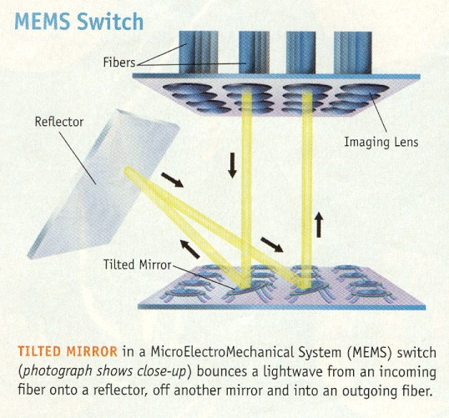
Historical Reason for Multi-layer
SONET over WDM
Conventional WDM deployment is using SONET as standard interface to higher layers
IP over ATM
IP packets need to be mapped into ATM cells before transporting over WDM using SONET frame
OEO conversions at every node is easier to build than all optical switch
Electronic
Network
Electronic
Network
O/E/O
E/O
E/O
O/E/O
O/E/O
O/E/O
O/E/O
O/E/O
E/O
E/O
Electronic
Network
Electronic
Network
Optical Core

Slide 40
Unit 3: Network Switching
3.1 What’s inside a router (basic concepts of switching)
3.2 Other interconnection devices
Physical-layer hubs
Link-layer switches
Link-layer bridges
Performance Comparison
3.3 Trend of simplifying architecture
IP over ATM
IP over SDH
IP over WDM
3.4 Switching technology
Switching concepts
Multilayer switching
MPLS
3.5 Data-center networking

Slide 41
IP-over-ATM Model
In the mid-1990s, certain ISPs evolved their networks from router-based cores to the overlay model of running IP over ATM
to support the explosive growth occurring in their networks (greater bandwidth, deterministic forwarding performance, and traffic engineering are needed)
One of the primary reasons that the IP-over-ATM overlay model was satisfying: ATM’s use of a label-swapping forwarding algorithm

Slide 42
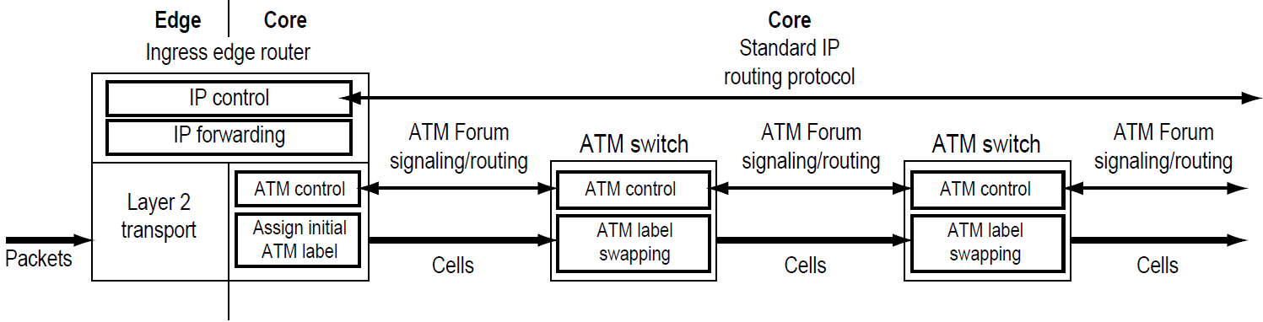
IP-over-ATM Model (cont.)
ATM software controls (signaling and routing) and hardware forwarding (label swapping) on every system in the core of the network.
The role of IP routing was limited to the edges of the network because this model viewed software-based routers as the key source of poor network performance.
Notes:
ATM is a core protocol used over the SONET/SDH backbone of the public switched telephone network (PSTN) and Integrated Services Digital Network (ISDN), but its use is declining in favour of all IP.
ATM eventually became dominated by Internet Protocol (IP) only technology (and Wireless or Mobile ATM never got any foothold).
But while ATM seems to be the perfect answer for WANs, many large companies are more likely to use a hybrid approach, such as Gigabit Ethernet over ATM, on LANs.

Slide 43
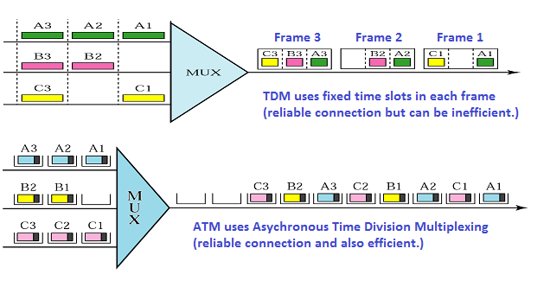
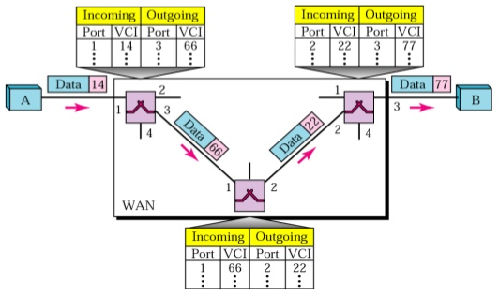
ATM

Slide 44
Asynchronous Transfer Mode: ATM
1990’s/00 standard for high-speed (155Mbps to 622Mbps and higher) Broadband Integrated Service Digital Network (B-ISDN) architecture
Goal: integrated, end-end transport of carry voice, video, data
meeting timing/QoS requirements of voice, video (versus Internet best-effort model)
“next generation” telephony: technical roots in telephone world
packet-switching (fixed length packets, called “cells”) using virtual circuits

Slide 45
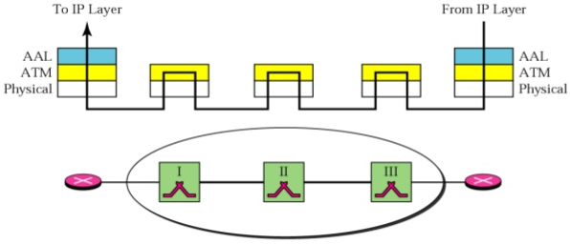
ATM architecture
AAL
AAL
ATM
ATM
ATM
ATM
physical
physical
physical
physical
end system
switch
switch
end system
adaptation layer: only at edge of ATM network
data segmentation/reassembly
roughly analagous to Internet transport layer
ATM layer: “network” layer
cell switching, routing
physical layer

Slide 46
ATM: network or link layer?
Vision: end-to-end transport: “ATM from desktop to desktop”
ATM is a network technology
Reality: used to connect IP backbone routers
“IP over ATM”
ATM as switched link layer, connecting IP routers
IP
network
ATM
network

Slide 47

ATM Virtual Circuits (VCs)
Advantages of ATM VC approach:
QoS performance guarantee for connection mapped to VC (bandwidth, delay, delay jitter)
Drawbacks of ATM VC approach:
Inefficient support of datagram traffic
Scalability problem: the bandwidth limitations of ATM SAR interfaces, the 20% cell tax, the “n-squared” permanent VC (PVC) problem, the Interior Gateway Protocol (IGP) stress, and the inability to operate over a non-ATM infrastructure.
Switched VC (dynamically set up on per-call basis) introduces call setup latency
The most challenging problem: the complexity of operating a network based on two disparate technologies that were independently designed and developed for entirely different tasks.

Slide 48
IP-Over-ATM
app
transport
IP
AAL
ATM
phy
app
transport
IP
Eth
phy
IP
AAL
ATM
phy
Eth
ATM
phy
phy
ATM
phy

Slide 49
Unit 3: Network Switching
3.1 What’s inside a router (basic concepts of switching)
3.2 Other interconnection devices
Physical-layer hubs
Link-layer switches
Link-layer bridges
Performance Comparison
3.3 Trend of simplifying architecture
IP over ATM
IP over SDH
IP over WDM
3.4 Switching technology
Switching concepts
Multilayer switching
MPLS
3.5 Data center networking

Slide 50
Digital Multiplexing Levels
DS3: 44.736 Mbit/s; E4: 139.264 Mbit/s
STS – synchronous transport signal (electrical signals)
OC – optical carrier (optical signals)
STM – synchronous transport module
SONET | SDH | Rate (Mbps) | SONET perf. | SDH perf.
STS-1, OC-1 | STM-0 | 51.840 | 1 DS3
STS-3, OC-3 | STM-1 | 155.520 | 3 DS3 | 1 E4
STS-12, OC-12 | STM-4 | 622.080 | 12 DS3 | 4 E4
STS-48, OC-48 | STM-16 | 2,488.320 | 48 DS3 | 16 E4
STS-192, OC-192 | STM-64 | 9,953.280 | 192 DS3 | 64 E4
DS0
…
MUX
DS1
24
MUX
DS2
Service adapter (SA)
64kbps
1.544Mbps
MUX
SA
STS-1
DS3
…
OC-N
44.736Mbps
…
MUX
STS-N
E/O
6.312Mbps
51.840Mbps
In: 24 DS0
Out: DS1
In: 4 DS1
Out: DS2
In: 7 DS2
Out: DS3
In: DS3
Out: STS-1
Notes:
Synchronous Optical Networking (SONET) and Synchronous Digital Hierarchy (SDH) are standardized protocols that transfer multiple digital bit streams synchronously over optical fiber using lasers or highly coherent light fromlight-emitting diodes (LEDs).
SONET and SDH, which are essentially the same, were originally designed to transport circuit mode communications (e.g., DS1, DS3) from a variety of different sources, but they were primarily designed to support real-time, uncompressed, circuit-switched voice encoded in PCM format.
Due to SONET/SDH's essential protocol neutrality and transport-oriented features, SONET/SDH was the obvious choice for transporting the fixed length Asynchronous Transfer Mode (ATM) frames also known as cells. It quickly evolved mapping structures and concatenated payload containers to transport ATM connections. In other words, for ATM (and eventually other protocols such as Ethernet), the internal complex structure previously used to transport circuit-oriented connections was removed and replaced with a large and concatenated frame (such as STS-3c) into which ATM cells, IP packets, or Ethernet frames are placed.

Slide 51
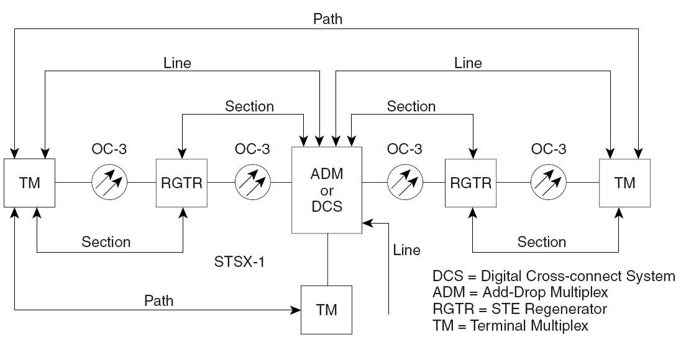
Typical SONET Levels
Notes:
Both SDH and SONET are widely used today: SONET in the United States and Canada, and SDH in the rest of the world. Although the SONET standards were developed before SDH, it is considered a variation of SDH because of SDH's greater worldwide market penetration. SONET is subdivided into four sublayer with some factor such as the path, line, section and physical layer.
The SDH standard was originally defined by the European Telecommunications Standards Institute (ETSI), and is formalized as International Telecommunication Union (ITU) standards G.707,^{[4]} G.783,^{[5]}G.784,^{[6]} and G.803.^{[7][8]} The SONET standard was defined by Telcordia^{[1]} and American National Standards Institute (ANSI) standard T1.105.^{[8][9]}

Slide 52
IP-over-SONET/SDH Protocol Stack
Payload
Payload
Path
Path
Line/ Multiplex
Line/ Multiplex
Section/ Regenerator
Section/ Regenerator
Section/ Regenerator
Photonic
Photonic
Photonic
media
media
Physical data flow
Logic data flow

Slide 53
Unit 3: Network Switching
3.1 What’s inside a router (basic concepts of switching)
3.2 Other interconnection devices
Physical-layer hubs
Link-layer switches
Link-layer bridges
Performance Comparison
3.3 Trend of simplifying architecture
IP over ATM
IP over SDH
IP over WDM
3.4 Switching technology
Switching concepts
Multilayer switching
MPLS
3.5 Data center networking

Slide 54
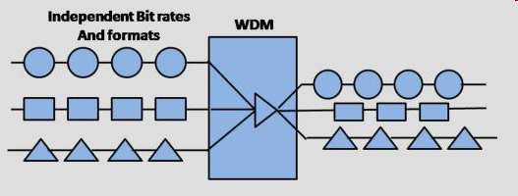
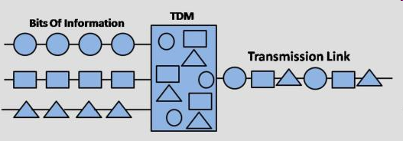
WDM and TDM
WDM (channels are called wavelengths)
Channel 4
Combining WDM and TDM
Bandwidth
Channel 3
Channel 2
Channel 1
Slot 4
Slot 4
Slot 4
Slot 4
λ4
Bandwidth
λ3
Time
Slot 3
Slot 3
Slot 3
Slot 3
Slot 2
Slot 2
Slot 2
Slot 2
λ2
TDM (channels are called time slots)
Slot 1
Slot 1
Slot 1
Slot 1
λ1
Channe l
1
Channe l
2
Channe l
3
Channe l
4
Time
Bandwidth
Time

Slide 55
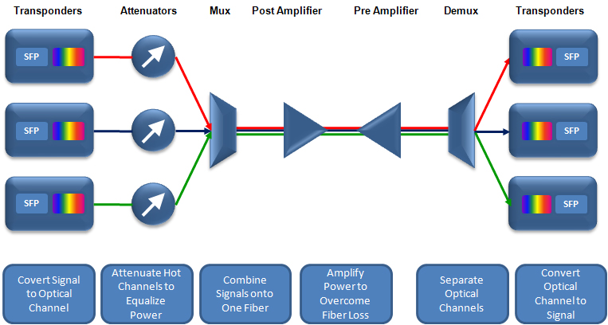
Dense Wavelength Division Multiplexing (DWDM)
DWDM is typically used where high capacity is needed over a limited fiber resource or where it is cost prohibitive to deploy more fiber.
DWDM circuits are the basis for all modern transatlantic cable systems and other long-haul circuits.

Slide 56
Optical Transport Network (OTN) Layered Model
User Protocol Data Unit (PDU)
Encapsulation
OCh Payload Unit (OPUk)
Decapsulation
Digital Transport Hierarchy
Digital Path Layer
OCh Data Unit (ODUk)
OCh Transport Unit (OTUk)
Digital Section Layer
Optical Channel Layer (OCh)
Optical Channel Layer
Optical Transport Hierarchy
Optical Channel Multiplexing
Optical Multiplex Section (OMS)
Optical Physical Section
Optical Transmission Section (OTS)
Fiber Medium (OTM-n.m)
OTM – Optical Transport Module

Slide 57
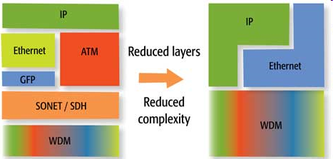
Trend of Simplifying Architecture
Notes:
GFP（通用成帧规程）技术

Slide 58
Simplified Protocol Stacks?
IP
IP
Frame Relay
WDM-aware
Electronic layer
ATM
SONET
WDM
WDM
Typical Protocol Stack
Simplified Protocol Stack

Slide 59
IP Directly Over WDM?
The basic concept is to transmit raw IP packets over the optical layer using DWDM for its capacity and operations.
Establish high-speed optical layer connections (lightpaths)
IP routers connected through lightpaths rather than fiber.

Slide 60
Protocol stack for IP over WDM
Layer 3
IP
IP
IP
Layer 2
Label switching MPLS
Label switching MPλS/GMPLS
Label switching
Optical packet switching
Wavelength switching
Layer 1
WDM transmission
WDM transmission
WDM transmission
T-Routers
OXC
OPS
Overlay model
Peer (integrated) model
Notes:
T-router是Overlay模型，而GMPLS和OPS是Peer模型

Slide 61
Unit 3: Network Switching
3.1 What’s inside a router (basic concepts of switching)
3.2 Other interconnection devices
Physical-layer hubs
Link-layer switches
Link-layer bridges
Performance Comparison
3.3 Trend of simplifying architecture
IP over ATM
IP over SDH
IP over WDM
3.4 Switching technology
Switching concepts
Multilayer switching
MPLS
3.5 Data-center networking

Slide 62
Switching Technology
Designed as a higher-speed alternative with a connection-oriented approach to connectionless packet forwarding
Uses faster array lookup instead of destination address lookup that requires longest-prefix table lookup
Often associated with Asynchronous Transfer Mode (ATM) because the two emerged at the same time

Slide 63
Switching Concept
S₂
0
S₀
S₁
0
0
1
S₃
label
action
label
action
0
0
Label→1; send out 0
0
Label→2; send out 1
1
Label→0; send out 0
1
Label→4; send out 1
2
Label→3; send out 0
2
Label→1; send out 0
3
Label→2; send out 0
3
Label→3; send out 1
A label is only needed when a flow is active
Label replacement known as label swapping
A label only needs to be valid across one hop
To avoid requiring global agreements on labels
A path through the network corresponds to a sequence of labels

Slide 64
Potential Advantages Of Switching For IP Forwarding
Faster forwarding
Use indexing in place of routing table lookup
Aggregated route information
Avoid having complete routing tables in each routers
Because the label is used to specify the next hop, many packets can be assigned the same label
Ability to manage aggregate flows
Service Level Agreements (SLAs) refer to aggregate traffic (e.g., all traffic between two ISPs)
One label can be assigned to each aggregate for easier management

Slide 65
The Evolution of Multilayer Switching in the Internet
Multilayer switching describes the integration of Layer 2 switching and Layer 3 routing.
Some ISP networks are built using an overlay model in which a logical IP routed topology runs over and is independent of an underlying Layer 2 switched topology (e.g., ATM or Frame Relay).
The difficulty lies in the complexity of mapping between two distinct architectures
The multilayer switching solutions and MPLS emerge to decrease complexity

Slide 66
Multilayer Switching Alternatives to the IP-over-ATM Model
not interoperable
By late 1996, proprietary multilayer switching solutions appeared which integrated ATM switching and IP routing
IP Switching designed by Ipsilon/Nokia
Cell Switching Router (CSR) developed by Toshiba
Tag Switching developed by Cisco Systems
Aggregate Route-Based IP Switching (ARIS) designed by IBM Corporation
IP Navigator delivered by Cascade/Ascend/Lucent Technologies
Data-driven model
Control-driven model (MPLS support)

Slide 67
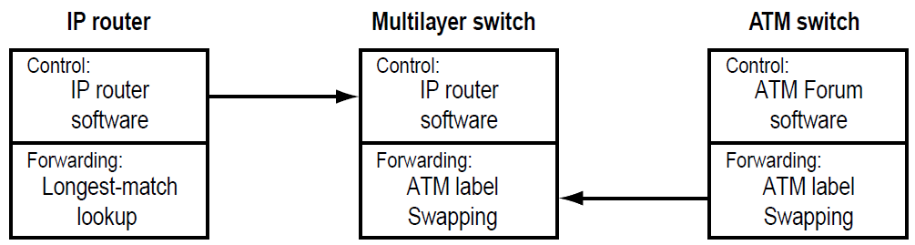
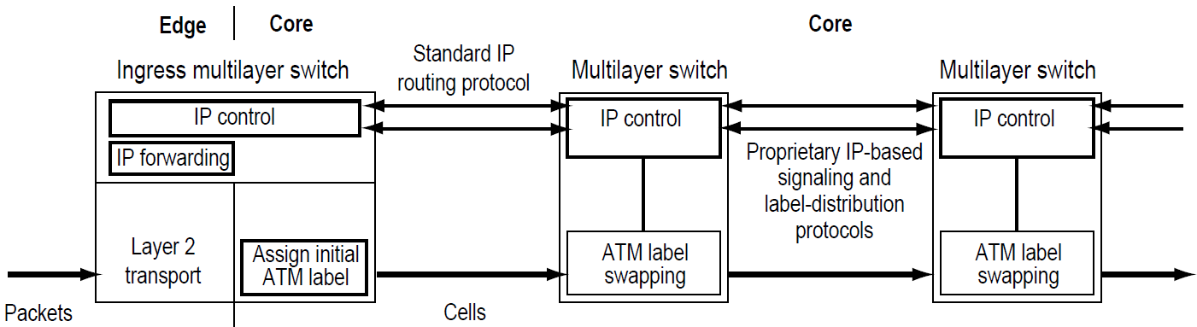
Multilayer Switch as a Fast IP Router

Slide 68
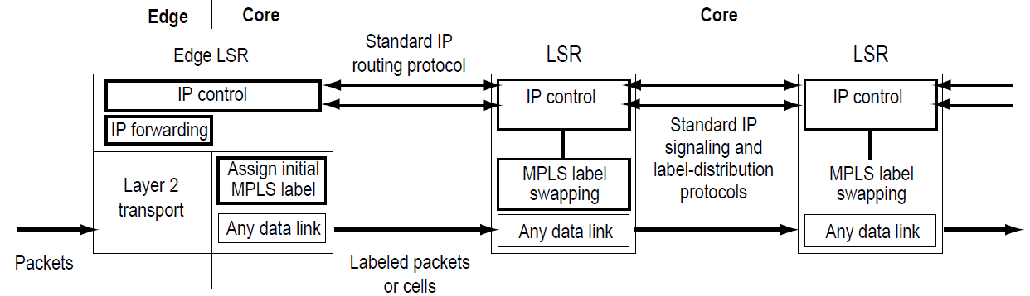
Multiprotocol Label Switching (MPLS)
the latest step in the evolution of multilayer switching in the Internet (an IETF standards-based approach)
uses the control-driven model to initiate the assignment and distribution of label bindings
support multivendor interoperability
does not implement ATM Forum signaling or routing protocols – the complexity of coordinating two different protocol architectures is eliminated

Slide 69
MPLS Encapsulation
MPLS forwarding component is based on the label-swapping algorithm.
If the Layer 2 technology supports a label field, the native label field encapsulates the MPLS label.
If not, the MPLS label is encapsulated in a standardized (fixed-length) MPLS header that is inserted between the Layer 2 and IP headers.
The MPLS header permits any link layer technology to carry an MPLS
32 bits
L2
header
IP header
remainder of link-layer frame
MPLS header
EXP : experimental use
S = 1: bottom of the stack
S = 0: other entries
label
Exp
S
TTL
20
3
1
8

Slide 70
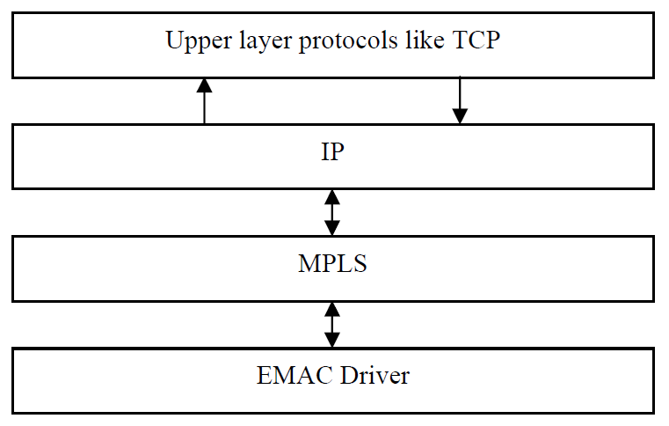
MPLS Layer
MPLS belongs to the family of packet-switched networks.
MPLS (“Layer 2.5” protocol) operates at a Layer between Layer 2 (Data Link Layer) and Layer 3 (Network Layer)

Slide 71
Main Terminology of MPLS
Label Switch Router (LSR) - Any router which is located in the MPLS domain and forwards the packets based on label switching is called LSR.
Label Edge Router (LER) – A packet enters into MPLS domain through LER which is called Ingress router. Packet leaves the MPLS domain through LER which is called Egress router.
Label Distribution Protocol (LDP) - It is a protocol and is responsible in establishing and maintaining labels.
Forward Equivalence Class (FEC) – This set of packets having related characteristics is bounded to the same MPLS label and are forwarded with the same priority in the same path. Each packet in MPLS network is assigned with FEC only once at the Ingress router.
Label Switched path (LSP) – LSP is the path set by the signaling protocols in MPLS domain. In MPLS domain there exists number of LSPs that originate at Ingress router and traverses one or more core LSRs and terminates at Egress router.

Slide 72
Processing An Incoming Datagram
Most MPLS systems perform classification at layer 4 or higher → Classification is used to assign a label.
Datagram classified → Multiple headers examined
Note: each label corresponds to ‘‘flow’’ that may include many TCP sessions
Layer 3 classification only uses fields in the IP header (e.g., source and dest. IP addresses, type of services)
Layer 4 classification schemes examine protocol port numbers in TCP or UDP header
Layer 5 classification looks further into the datagram and considers the payload

Slide 73
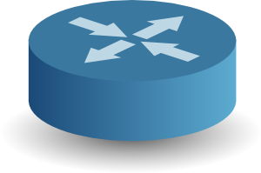

MPLS Operation
Ordinary IP Router
LSR – Label Switch Router
LER – Label Edge Router
MPLS
MPLS-enabled IP Router
In Label | In Int | Out Int | Out Label
4 | 2 | 0 | 7
5 | 2 | 1 | 9
… | … | … | …
In Label | In Int | Out Int | Out Label
7 | 1 | 0 | 8
… | … | … | …
FEC | Out Int | Out Label
a | 1 | 4
b | 1 | 5
… | … | …
0
0
1
0
1
2
MPLS
7
MPLS
8
MPLS
1
Egress LER
1
4
In Label | In Int | Out Int | Out Label
8 | 1 | 0 | -
… | … | … | …
5
9
MPLS
Ingress LER
MPLS
MPLS
FEC – Forwarding Equivalence Class
Network Switching
3-73

Slide 74
Hierarchical MPLS
Multi-level hierarchy is possible
Example: corporation with three campuses and multiple buildings on each campus
– Conventional forwarding within a building
– One level of MPLS for buildings within a campus
– Additional level of MPLS between campuses
To accommodate hierarchy, MPLS uses a label stack
MPLS Label processing:
Only top label is used to forward
When entering a new level of hierarchy, push additional label
When leaving a level of the hierarchy, pop the top label

Slide 75
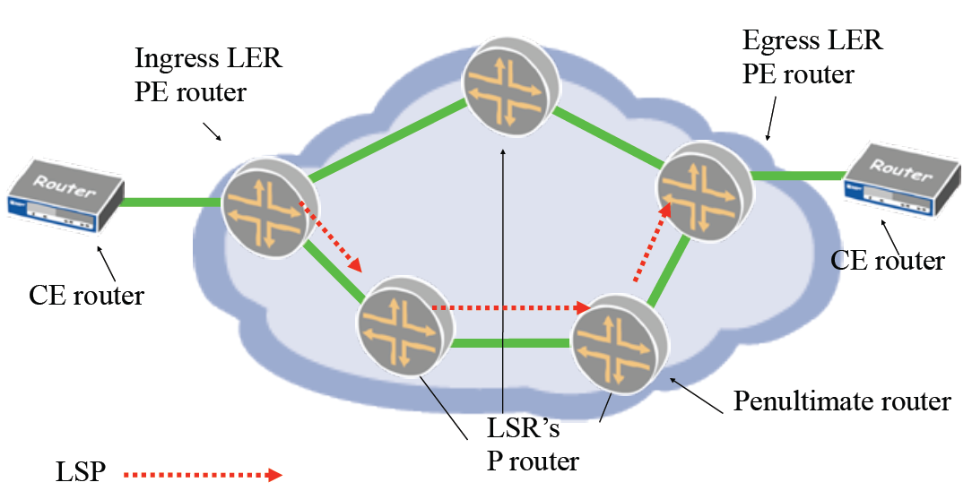
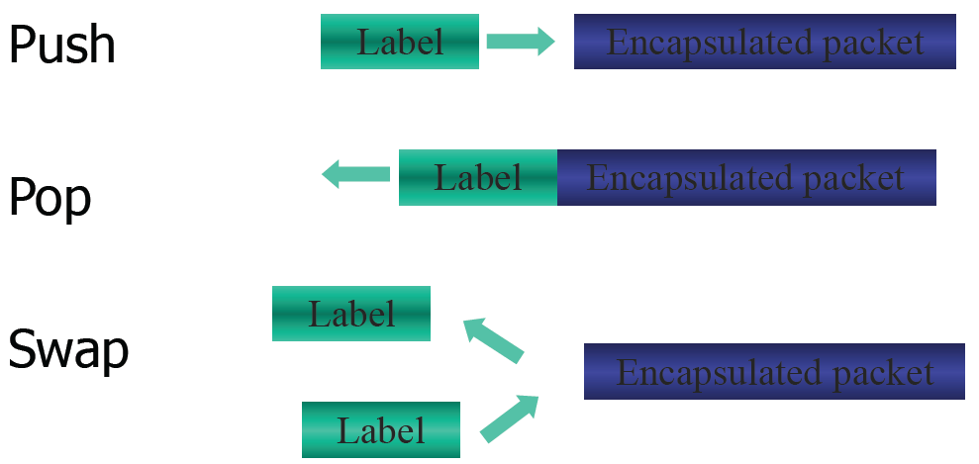
Notes:
Penultimate [pi’nultimit] adj.
Next to last.
倒数第二的：最后一个的前一个

Slide 76
Next Hop Label Forwarding Entry (NHLFE)
Found in Next Hop Label Forwarding Table (NHLFT)
Specifies
– Next hop information
(e.g., the outgoing interface)
– Operation to be performed
– Encapsulation to use (optional)
– How to encode the label (optional)
– Other information needed to
handle the packet (optional)
Replace label at top of stack
Pop label at top of stack
Replace label at top of stack, and then push one or more new labels onto stack

Slide 77
Control Processing And Label Distribution
Except data path processing, control path processing is needed to establish LSP
Primary function: automatic selection of labels
Label Distribution: process of choosing labels along a path
Protocols for MPLS control
Label Distribution Protocol (LDP)
Constraint-based Routing LDP (CR-LDP)
Extended OSPF, BGP, RSVP
No defined LDP standards yet

Slide 78
Notes About Fragmentation
Outgoing
– If datagram exactly fills network MTU, adding a 32-bit MPLS header will make the payload exceed MTU. Fragmentation will be required.
Incoming
– Classification requires knowledge of headers (e.g., TCP port numbers)
– Only first fragment contains needed information
– LSR must collect fragments and reassemble before classification

Slide 79
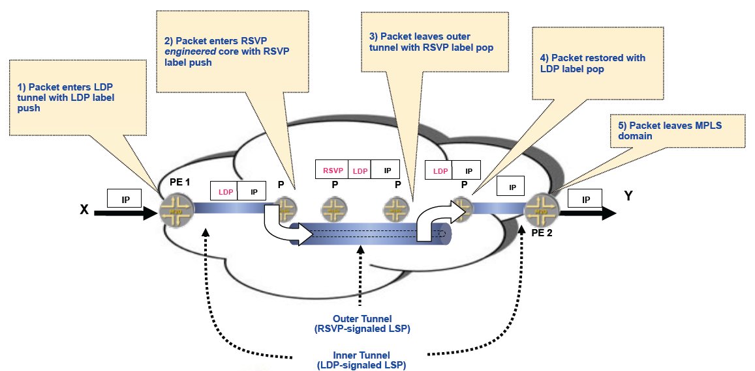
Example of Label Stacking

Slide 80
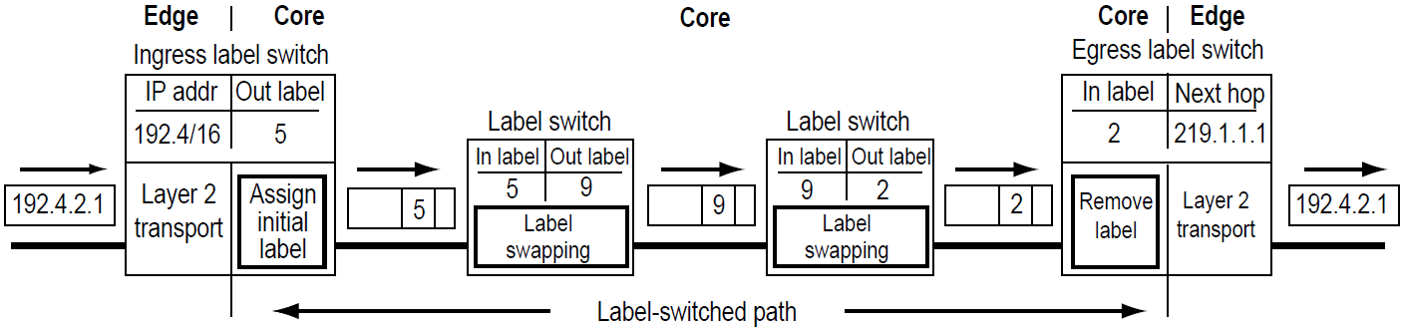
Packet Traversing a LSP

Slide 81
Emphasis and advantages of MPLS
The emphasis of our discussion of MPLS:
MPLS performs switching based on labels, without needing to consider the IP address of a packet.
The true advantages of MPLS and the reason for current interest in MPLS, however, lie not in the potential increases in switching speeds, but rather in the new traffic management capabilities that MPLS enables.

Slide 82
MPLS Applications
the primary application
Traffic Engineering
Class of Service (CoS)
Virtual Private Networks (VPNs)

Slide 83
Mesh Topology and Traffic Engineering
Full mesh often used in many MPLS cores
LSP established between each pair of LSRs
Parallel LSPs can be used for levels of service. For example:
One LSP with minimum hops might be reserved for VOIP traffic; another longer LSP might be used for all other traffic (e.g., e-mail and web traffic)
Traffic Engineering: use QoS to control the rate of traffic on each path. For example:
Define two MPLS flows over a single physical connection, use QoS to guarantee 75% of the bandwidth is devoted to one flow and the other flow receives 25%.

Slide 84
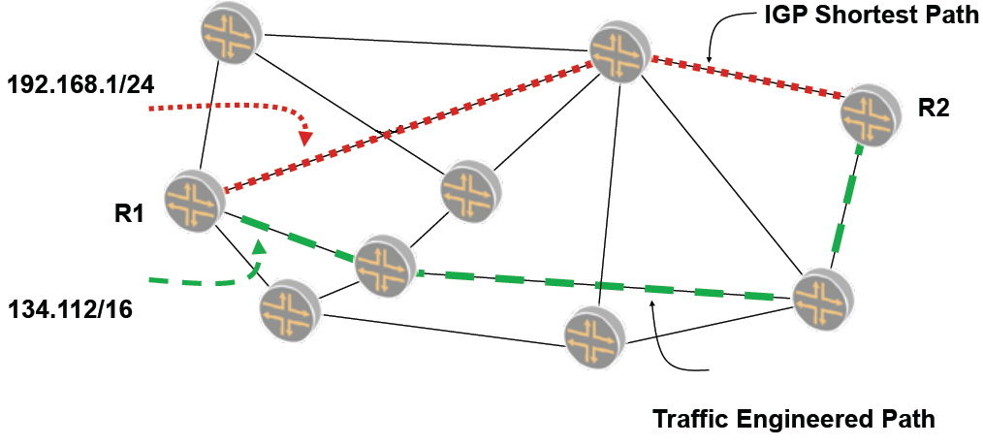
MPLS-based Traffic Engineering
allows ISPs to move traffic flows away from the shortest path calculated by the IGP and onto potentially less congested physical paths
Notes:
interior gateway protocol (IGP)

Slide 85
Class of Service
Support for differentiated services (DiffServ).
An ISP can take two approaches to support MPLS-based class of service forwarding:
1. Traffic can be queued
2. Multiple LSPs between each pair of edge LSRs can be provided.
High priority traffic
LSP 1
Medium priority traffic
LSP 2
LSP 3
Best-effort traffic
Head end
Tail end
LSP 4
Less-than-best-effort traffic

Slide 86
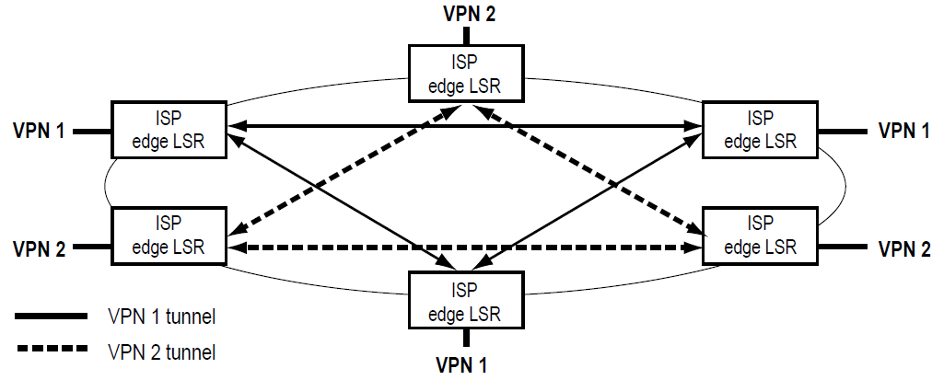
MPLS Facilitates the Deployment of VPNs
MPLS allows ISPs to offer VPN services by providing a simple, flexible, and powerful tunneling mechanism

Slide 87
Summary of MPLS
Specifically designed to run over any link-layer technology—not just an ATM infrastructure
Facilitates the migration to the next-generation optical Internet based on SONET/WDM and IP/WDM infrastructures.
Permits ISPs to deliver new services that cannot be readily supported by conventional IP routing techniques
Simpler network design and operation
Improved scalability
Notes:
One of the most important benefits of MPLS is that it permits ISPs to deliver new services that
cannot be readily supported by conventional IP routing techniques

Slide 88
Unit 3: Network Switching
3.1 What’s inside a router (basic concepts of switching)
3.2 Other interconnection devices
Physical-layer hubs
Link-layer switches
Link-layer bridges
Performance Comparison
3.3 Trend of simplifying architecture
IP over ATM
IP over SDH
IP over WDM
3.4 Switching technology
Switching concepts
Multilayer switching
MPLS
3.5 Data-center networking

Slide 89


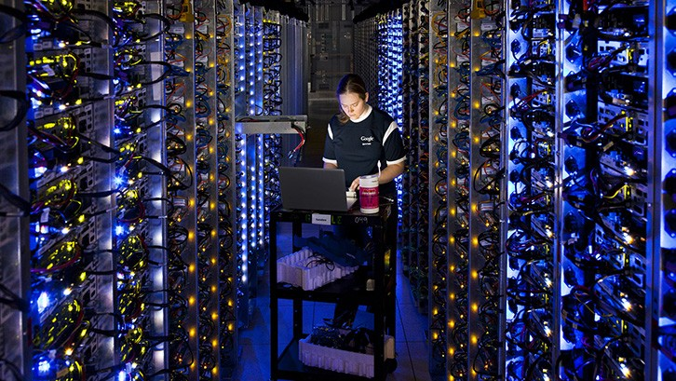
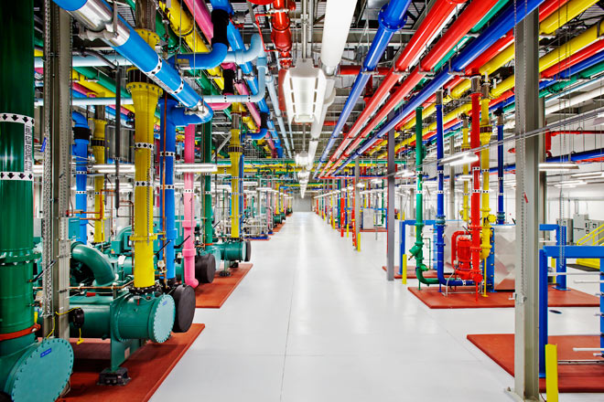
Data Center Networking
In recent years, Internet companies such as Google, Microsoft, Facebook, and Amazon have built massive data centers,
each housing tens to hundreds of thousands of hosts, and concurrently supporting many distinct cloud applications.
Each data center has its own data center network that interconnects its hosts with each other and interconnects the data center with the Internet.
Notes:
Cooling systems
A central cooling plant

Slide 90

The cost of a large data center
> $12 million per month for a 100,000 host data center
A breakdown of the costs:
45% can be attributed to the hosts themselves (which need to be replaced every 3–4 years);
25% to infrastructure, including transformers, UPS, generators for long-term outages, and cooling systems;
15% for electric utility costs for the power draw;
15% for networking, including network gear (switches, routers and load balancers), external links, and transit traffic costs.
While networking is not the largest cost, networking innovation is the key to reducing overall cost and maximizing performance

Slide 91
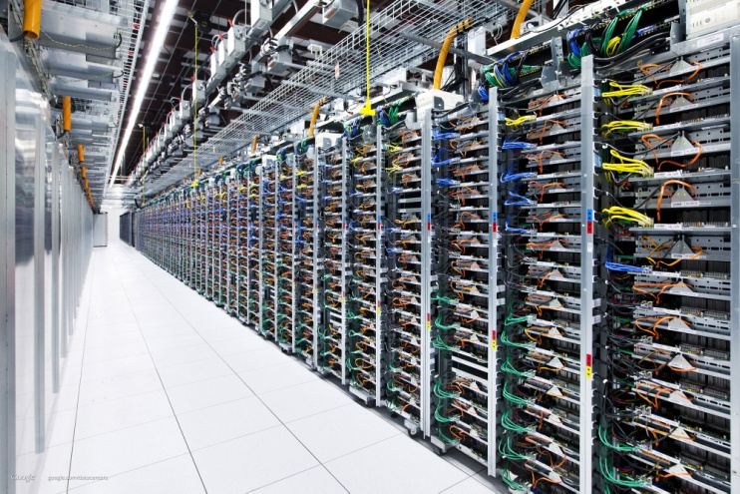
Hosts in Data Centers (1)
The worker bees in a data center are the hosts:
They serve content (e.g., Web pages and videos), store emails and documents, and collectively perform massively distributed computations (e.g., distributed index computations for search engines).
The hosts in data centers, called blades and resembling pizza boxes, are generally commodity hosts that include CPU, memory, and disk storage.
The hosts are stacked in racks, with each rack typically having 20 to 40 blades.
Notes:
Aptly
英 ['æptlɪ]美 [ˈæptlɪ]
adv.适当地，适切地，巧妙地
网 络适当地；
适宜地；
恰当地，贴切地；
恰当的
报 错

Slide 92
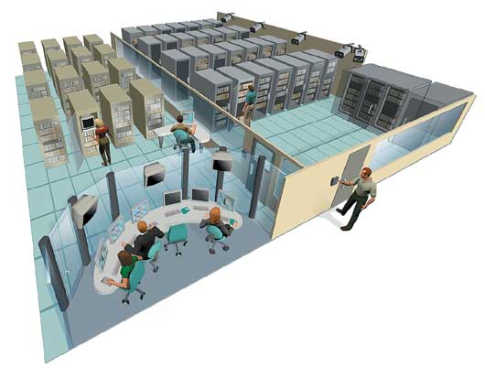
Hosts in Data Centers (2)
At the top of each rack there is a switch, aptly named the Top of Rack (TOR) switch, that interconnects the hosts in the rack with each other and with other switches in the data center.
Specifically, each host in the rack has a network interface card that connects to its TOR switch
each TOR switch has additional ports that can be connected to other switches.
Each host is also assigned its own data-center-internal IP address.

Slide 93
Supported Traffic in Data Centers
The data center network supports two types of traffic:
traffic flowing between external clients and internal hosts
the data center network includes one or more border routers, connecting the data center network to the public Internet.
The data center network therefore interconnects the racks with each other and connects the racks to the border routers.
traffic flowing between internal hosts.

Slide 94
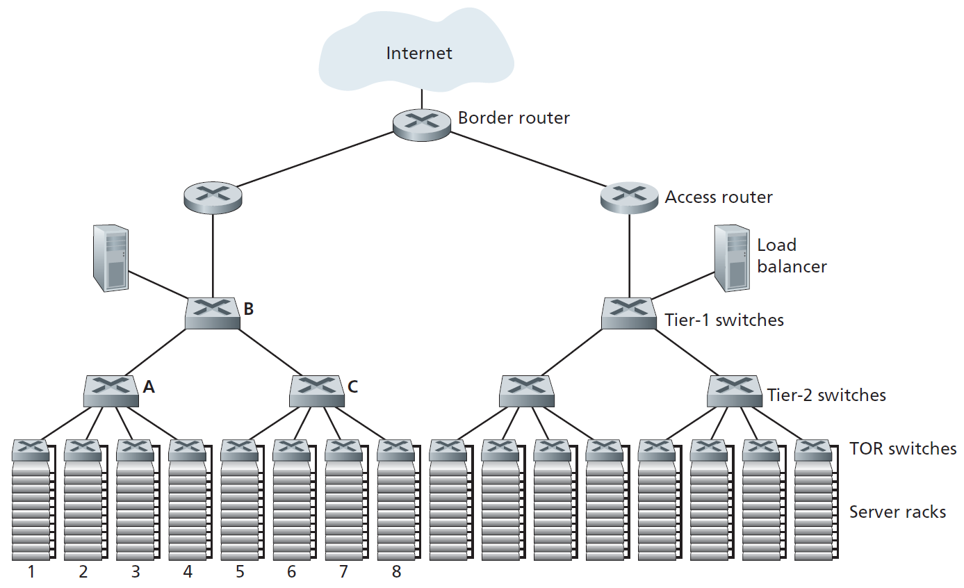
A data center network with a hierarchical topology
Data center network design, the art of designing the interconnection network and protocols that connect the racks with each other and with the border routers, has become an important branch of computer networking research in recent years

Slide 95
Load Balancing (1)
A cloud data center provides many applications concurrently.
each application is associated with a publicly visible IP address to which clients send their requests and from which they receive responses.
Inside the data center, the external requests are first directed to a load balancer
whose job it is to distribute requests to the hosts, balancing the load across the hosts as a function of their current load.
A large data center will often have several load balancers, each one devoted to a set of specific cloud applications.

Slide 96
Load Balancing (2)
Such a load balancer is sometimes referred to as a “layer-4 switch”
since it makes decisions based on the destination port number (layer 4) as well as destination IP address in the packet.
The load balancer not only balances the work load across hosts, but also provides a NAT-like function.

Slide 97
Hierarchical Architecture
A data center often employs a hierarchy of routers and switches (as shown in Slide 94)
Due to the requirement of high availability, data centers also include redundant network equipment and redundant links in their designs.
For example, each TOR switch can connect to two tier-2 switches, and each access router, tier-1 switch, and tier-2 switch can be duplicated and integrated into the design.
Although the conventional hierarchical architecture just described solves the problem of scale, it suffers from limited host-to-host capacity.

Slide 98
Trends in Data Center Networking
In order to reduce the cost of data centers, and at the same time improve their delay and throughput performance, Internet cloud giants (such as Google, Facebook, Amazon, and Microsoft) are continually deploying new data center network designs.

Slide 99
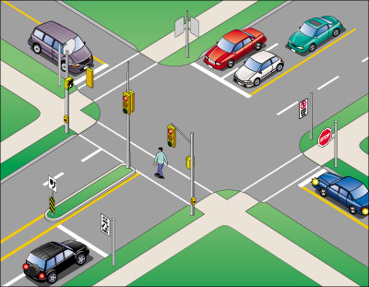
Homework 1
Where does queuing occur in a router? Give your detailed explanation about the location and extent of the queuing.

Slide 100
Homework 2
Describe the status quo of MPLS applications.

Slide 101
Homework 3
Find present routers for access networks, regional networks and WAN.

Slide 102
The 4th homework (1)
Describe the working process of a load balancer in a data center (you can refer to the textbook)

Slide 103
The 4th homework (2)
Describe the limited host-to-host capacity problem occurred in the Hierarchical Architecture of data centers (you can refer to the textbook) and possible solutions.

Slide 104
The 4th homework (3)
Search the relevant literature and our textbook, try to describe the trends in data center networking.

Slide 105
The 4th homework (4)
Brief introduction about VPN

Slide 106
Homework 2
Please describe the procedure of MPLS operation shown in slide 73
It is possible to check with the textbook

Slide 107
Homework 3
Brief description about current Internet Architecture

